Slide 1
Secure Data hiding in images using steganography
Presented By: Rishi Bothra
Student Name : Rishi Bothra
College Name & Department : Indus Univeristy , CSE Department

Slide 2
OUTLINE
Problem Statement
Technology used
Wow factor
End users
Result
Conclusion
Git-hub Link
Future scope

Slide 3
Problem Statement
Develop a Python-based steganography tool that uses the Least Significant Bit (LSB) technique to hide and extract secret text messages within digital images. The tool should support image formats like PNG and JPEG, ensure minimal distortion of the original image, and include error handling. Additionally, it should provide an option to encrypt messages before embedding for enhanced security.

Slide 4
Technology used
Platform:- IDLE Python-Version 3.11 64 bit
Libraries:-1. Open cv(cv2):For Image manipulation and processing
2.Numpy:For handling image data in array form and Numerical Operations on the Image Data.

Slide 5
Wow factors
Unique Features that Make This Steganography Project Stand Out:
Password Protection: The project implements a passcode-based authentication system, ensuring that only authorized users can decode hidden messages.
Custom Message Length Handling: It dynamically calculates the message length and ensures it fits within the image capacity, avoiding data overflow issues.
Special Character Marker: Uses a special end character (¶) to mark the end of the hidden message, ensuring accurate extraction without noise.
File-Based Password Storage: Passwords are securely stored in a file for later authentication during the decryption process.
Image Integrity Preservation: The tool utilizes PNG format for output, preventing lossy compression and maintaining the integrity of the hidden message.
These features enhance the security, usability, and reliability of the steganography project compared to basic implementations.

Slide 6
End users
Other End Users of This Steganography Project:
Software Developers and Programmers: To implement and test secure data-hiding techniques in software applications.
Educational Institutions and Students: For learning and teaching cryptography, data security, and image processing concepts.
Digital Forensics Experts: To detect and analyze hidden data in digital images during investigations.
Cloud Service Providers: For embedding metadata or confidential information within images for secure cloud storage.

Slide 7
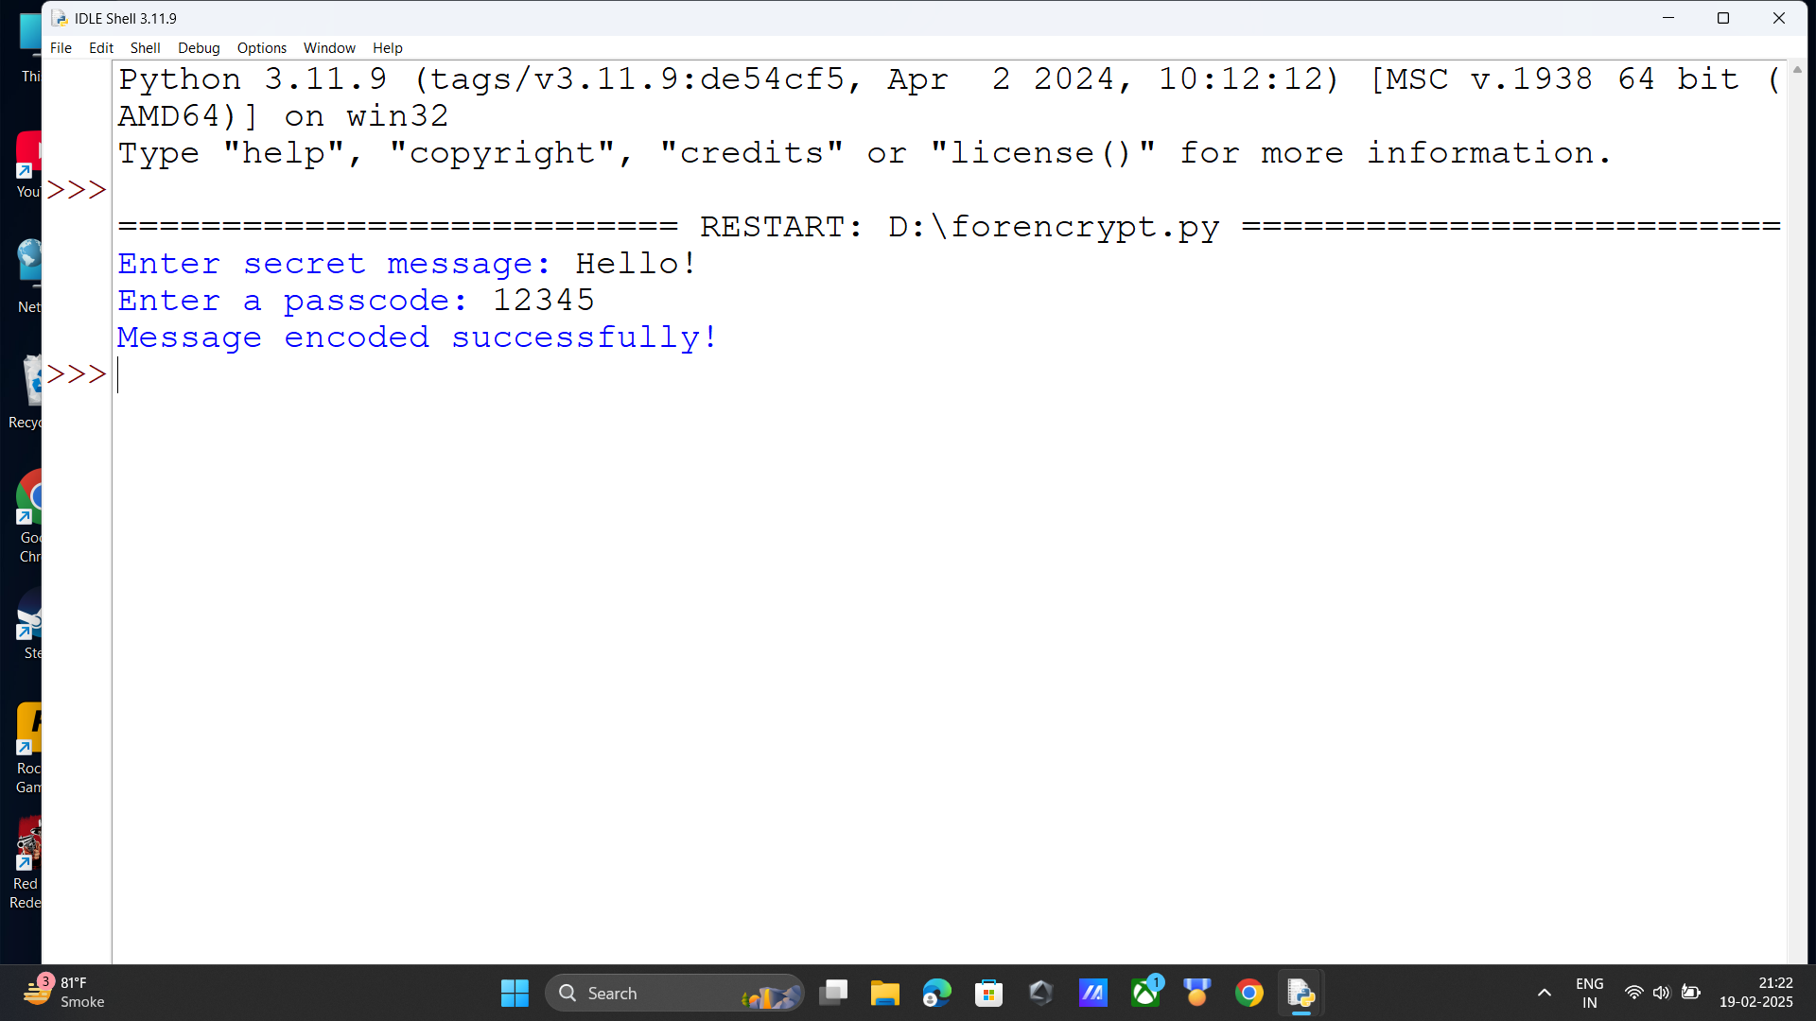
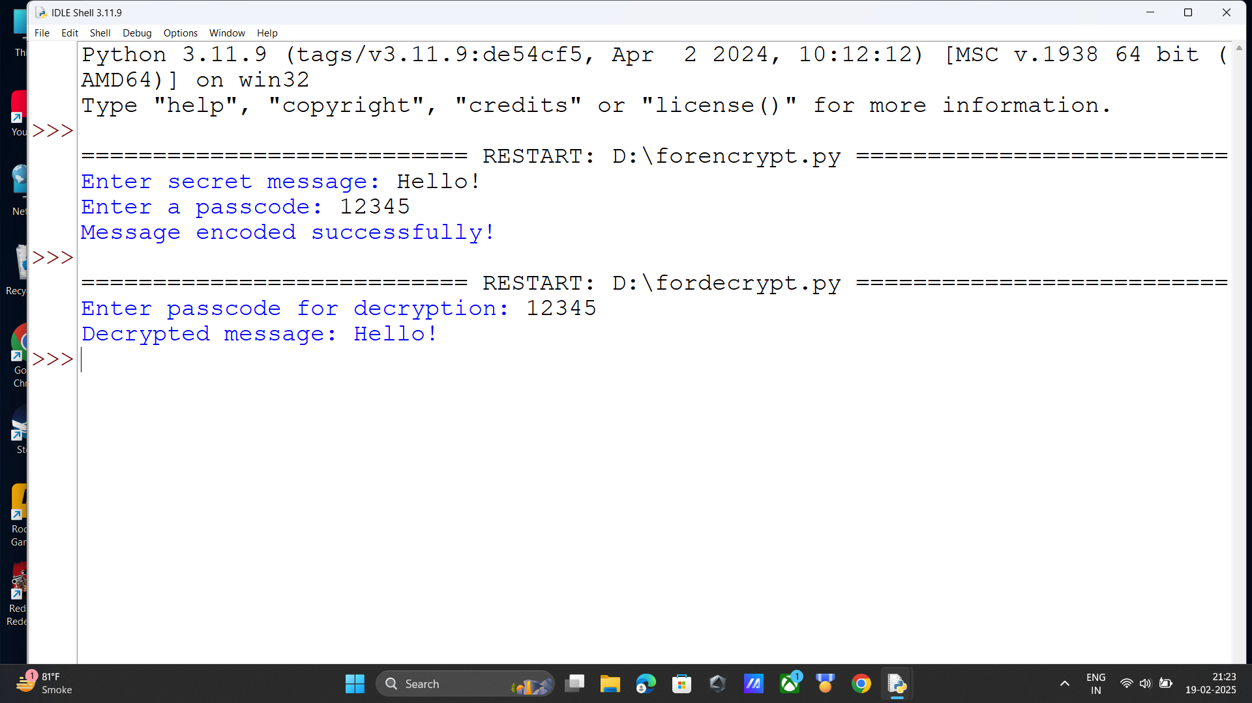
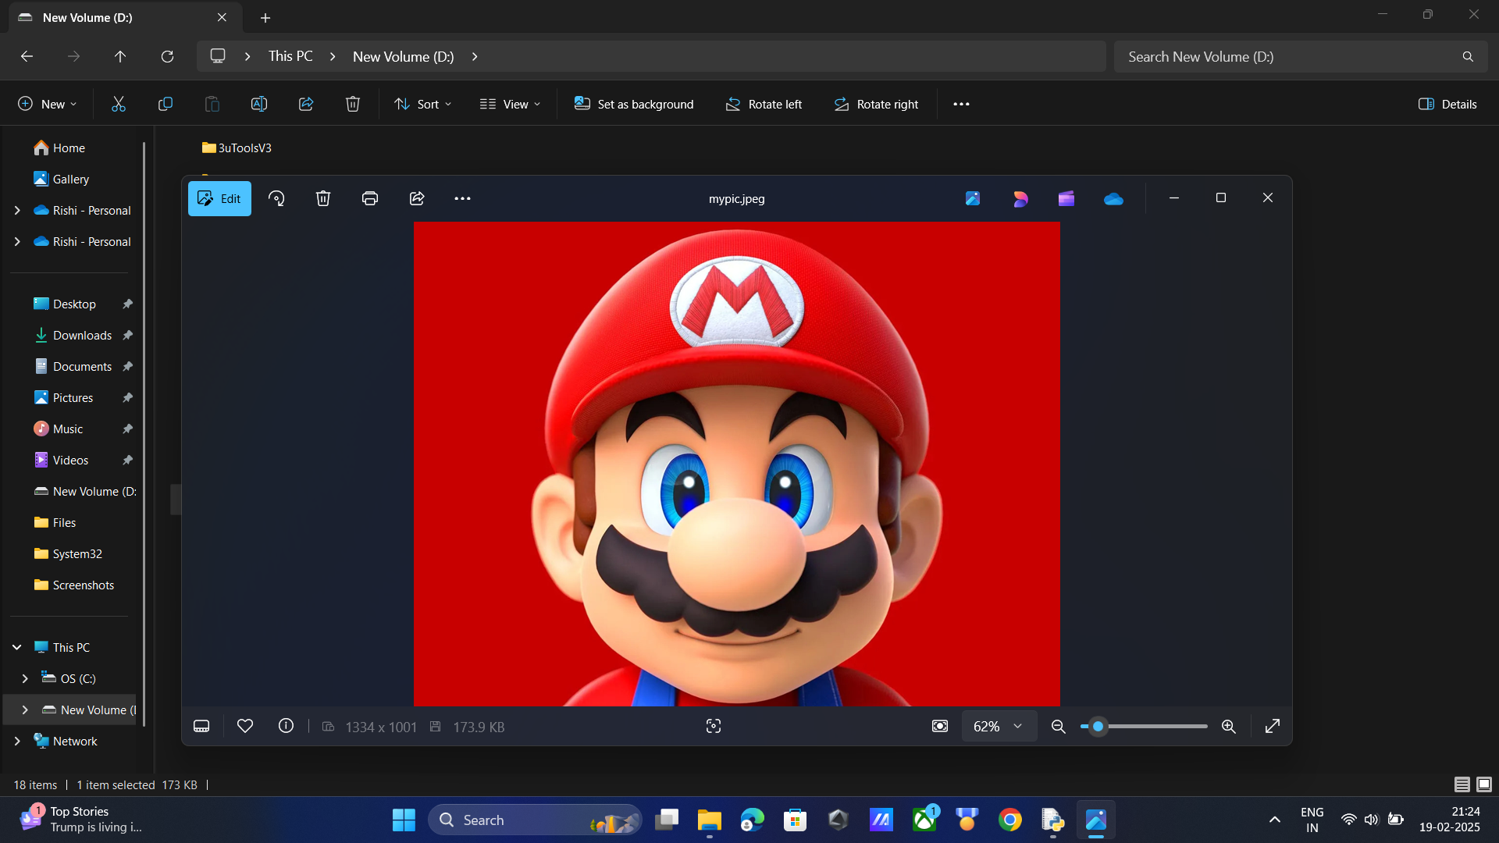

Results

Slide 8
Conclusion
Project Conclusion:
This Python-based steganography project successfully addresses the problem of secure communication by embedding hidden text messages within digital images. Utilizing libraries like OpenCV and NumPy, the project implements a robust Least Significant Bit (LSB) method for data hiding. The addition of password protection ensures that only authorized users can access the concealed information. This solution not only preserves image quality but also enhances data security, making it suitable for applications in cybersecurity, digital forensics, and confidential communication. The project demonstrates an effective blend of image processing and data encryption, fulfilling its objective of secure message transmission through steganography.

Slide 9
GitHub Link
https://github.com/RishiBothra019/Secure-Data-Hiding-in-Images-using-Steganography-EDUNET-INTERNSHIP.git

Slide 10
Future scope(optional)
Future Scope of the Steganography Project:
Integration with Encryption Algorithms: Enhancing the project by integrating advanced encryption algorithms (such as AES or RSA) to encrypt the message before embedding it in the image for added security.
Support for Multiple File Formats: Expanding support to various multimedia formats like audio, video, and PDF files for broader data hiding applications.
Adaptive Steganography Techniques: Implementing adaptive steganography methods that select specific regions of the image to hide data, making detection even more difficult.
Cloud-Based Implementation: Hosting the project on cloud platforms to provide steganography services online, enabling users to securely hide and extract data without local installations.
Mobile Application Development: Creating a mobile application to provide users with on-the-go access to steganography tools for secure communication on smartphones.

Slide 11
THANK YOU

